Slide 1
Rescue Bot- Team The Dark Knights
BY: Bheeshmaraya Bheemasamudra Vruksharaj Mehul kumar uttamchand
Sai Krupa Peraka

Slide 2

Contents
Introduction
Requirement Diagram
Use case Diagram
Block Diagram
Functional Diagram
Component Diagram
Activity Diagram
Application scenario
Environmental Diagram
System of Objectives
Uppal Model
Decision Tree
Reference

Slide 3
Introduction
Robots for rescue operations come under mechatronic systems since they involve design of mechanical as well as electronic systems for sensing and actuating units.
Our task is to develop a robot which is robust ,capable of moving on land and in water , assist in recovery and exploration of dangerous situations.
It should be able to communicate with environment and work in coordination with other bots when needed.

Slide 4
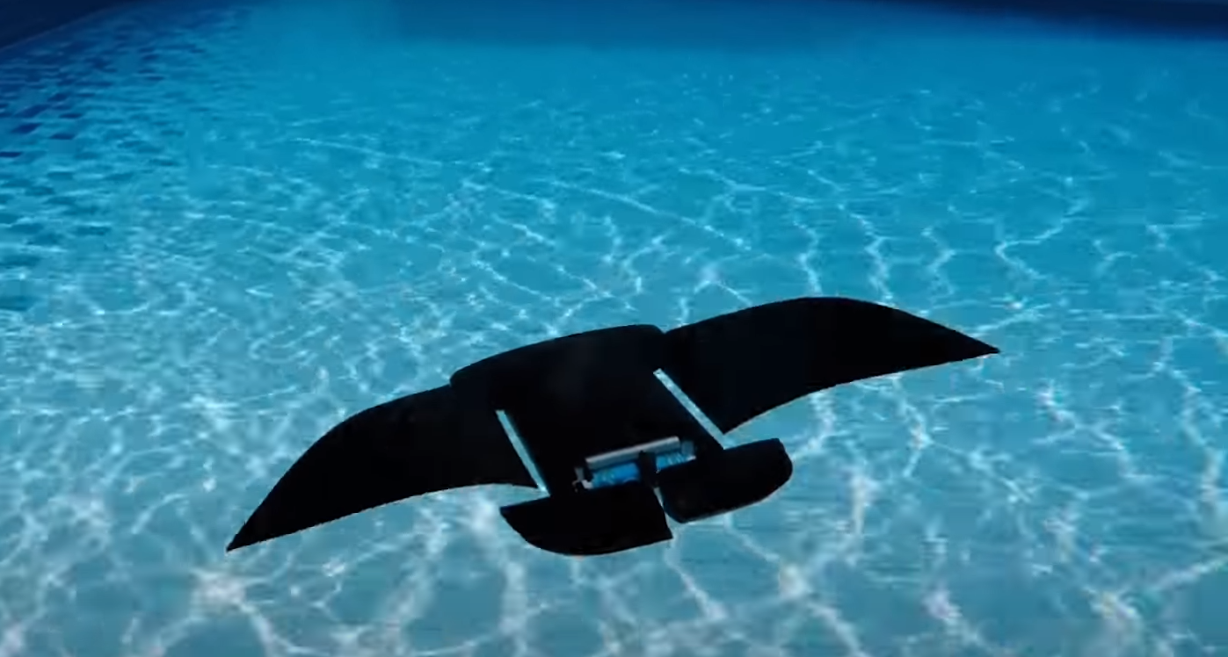
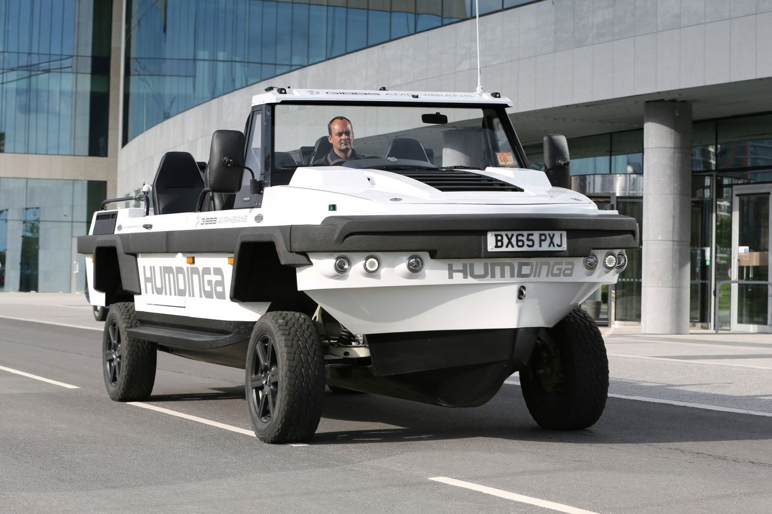
Rescue Bot- Dark Knight

Slide 5
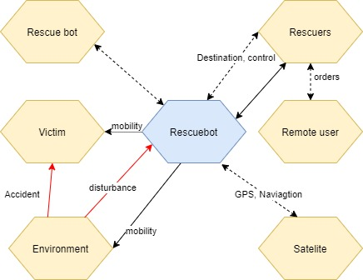




Environmental Diagram

Slide 6
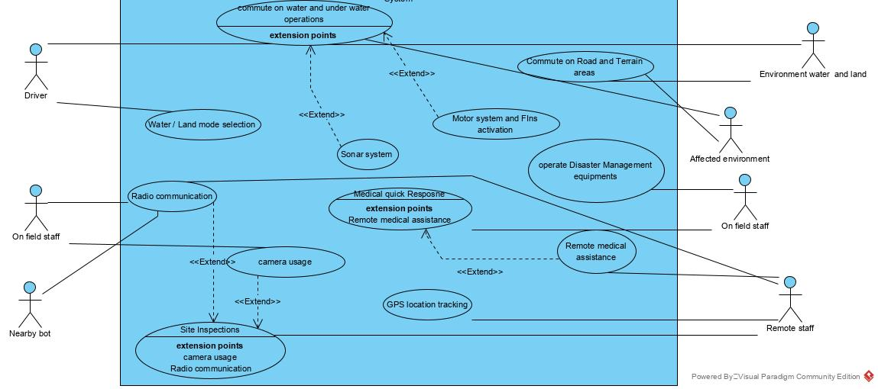
Use Case Diagram

Slide 7
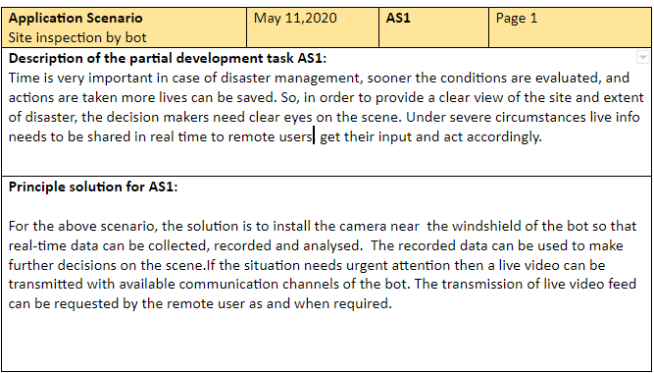
Application Scenarios

Slide 8
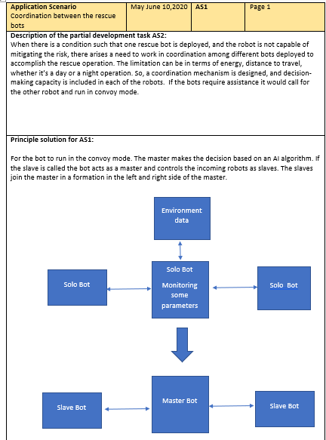
Application Scenarios

Slide 9
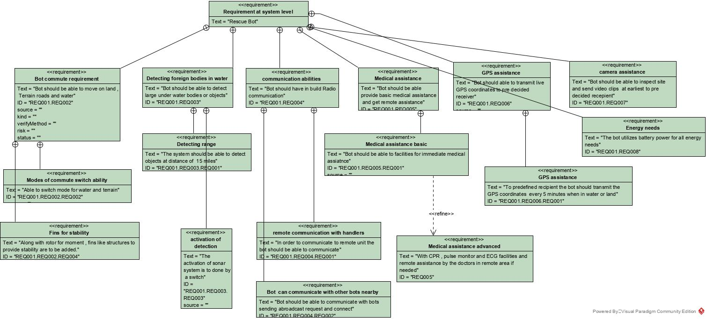
Requirement Diagram

Slide 10
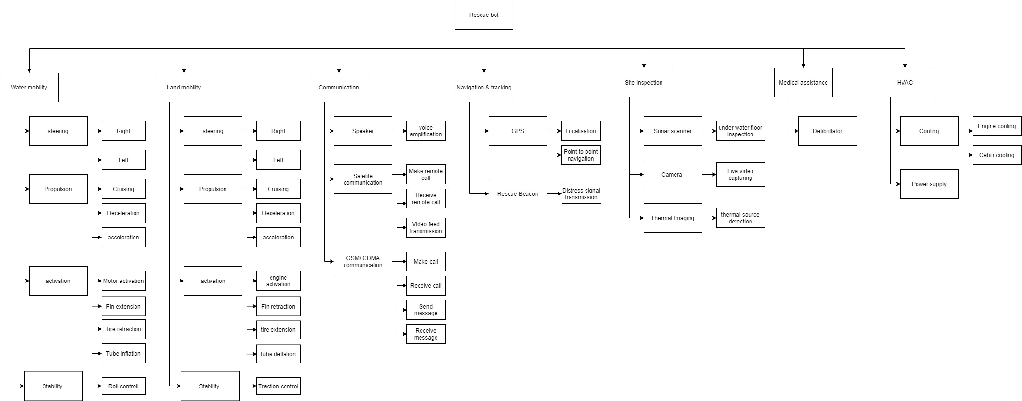
Functional Diagram

Slide 11
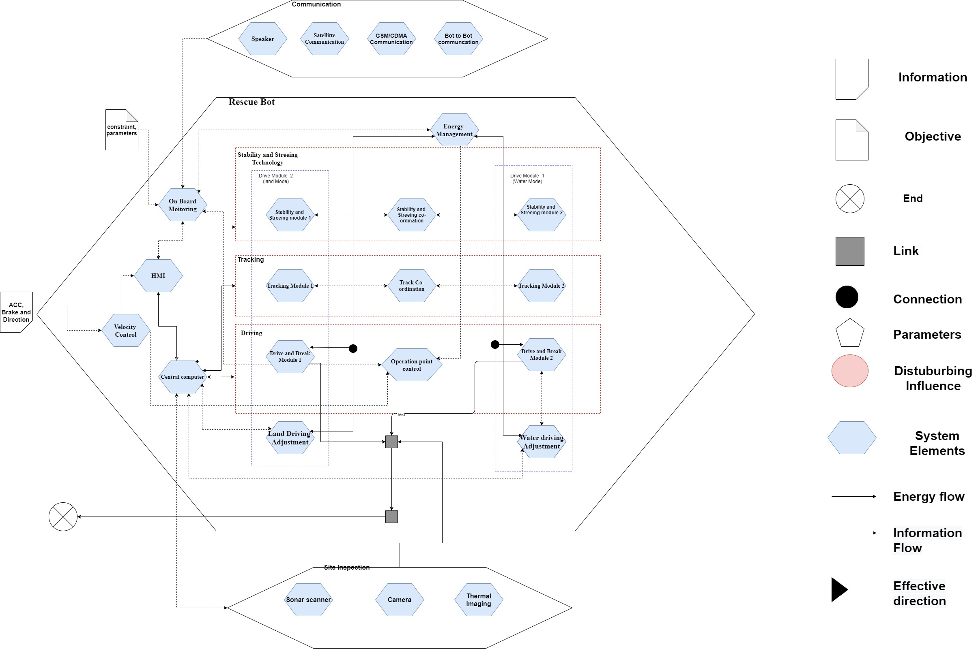
Activity Structure

Slide 12
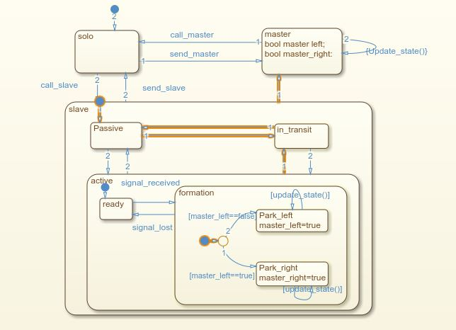
State Chart Diagram

Slide 13
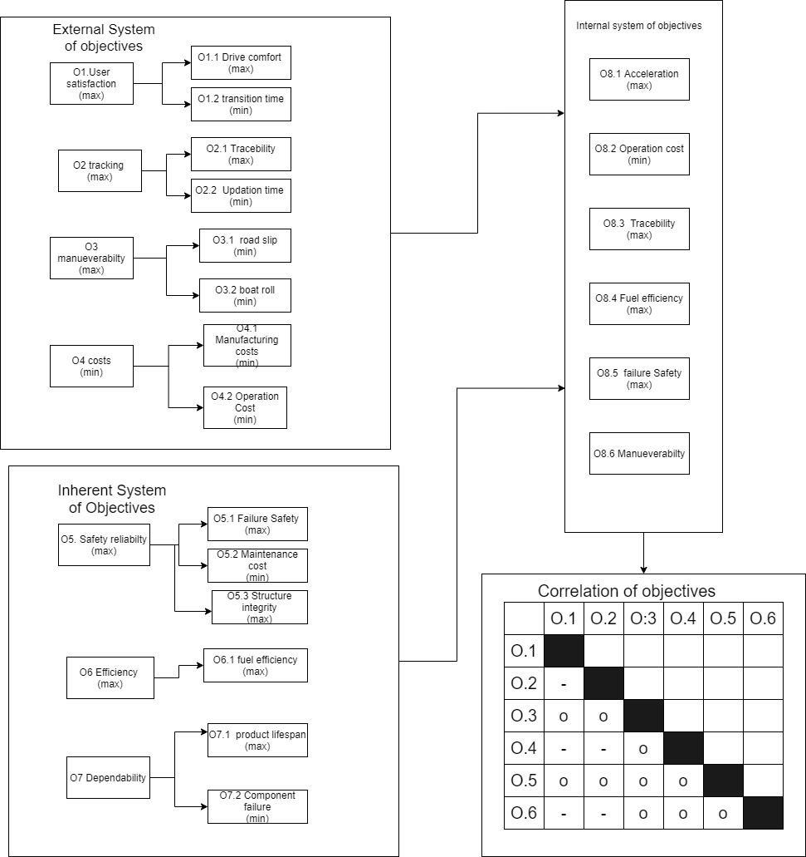
System of Objectives

Slide 14
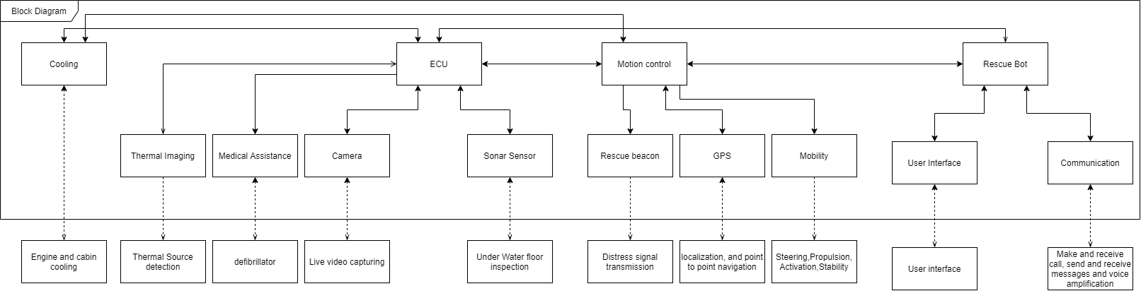
Internal Block Diagram

Slide 15
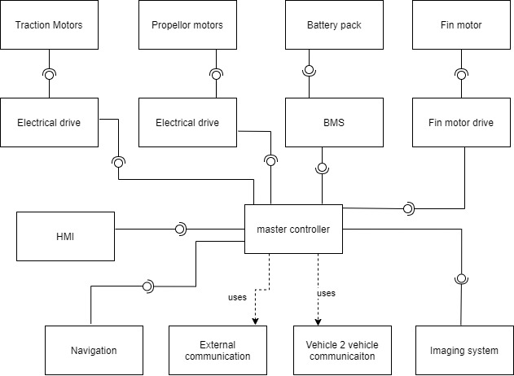
Component Diagram

Slide 16
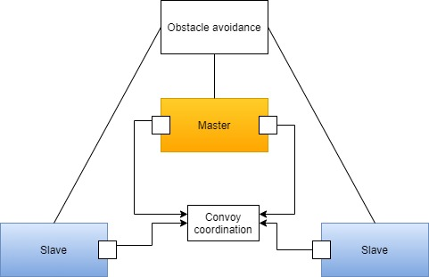
Uppaal Model

Slide 17
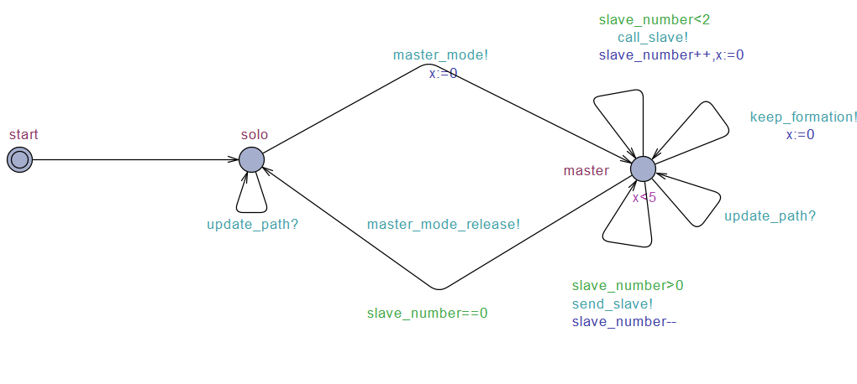
Master Control

Slide 18
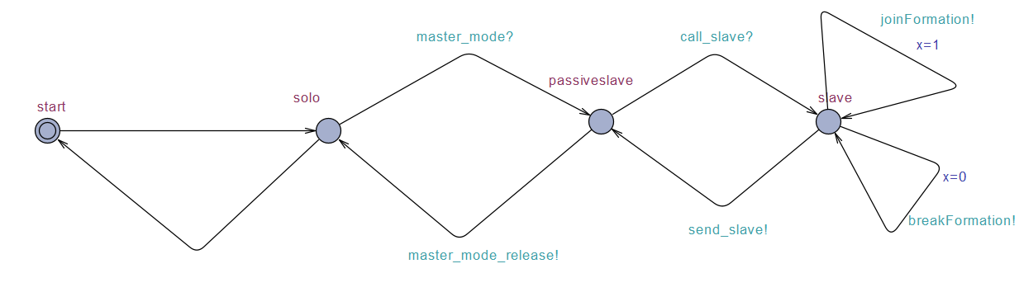
Slave Control

Slide 19
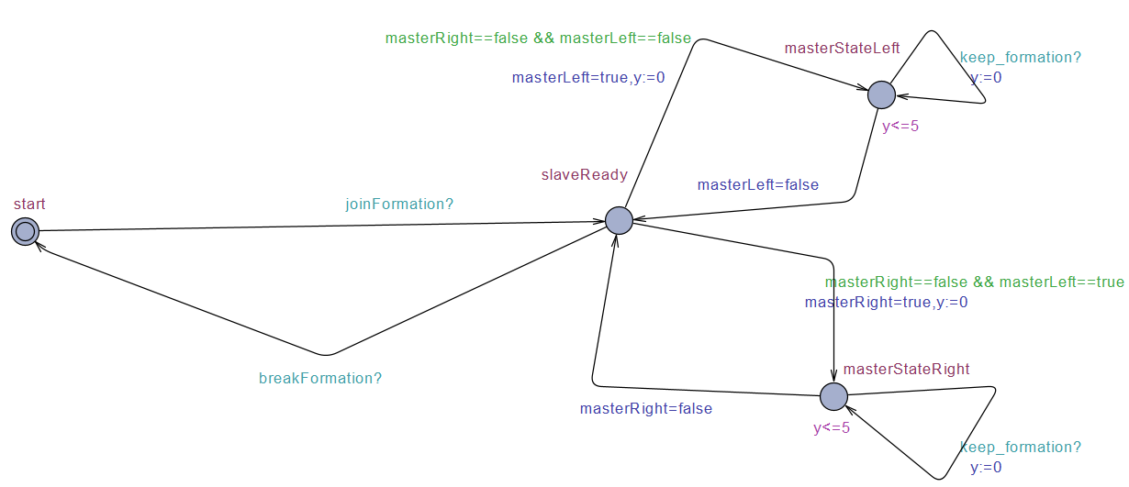
Slave position

Slide 20
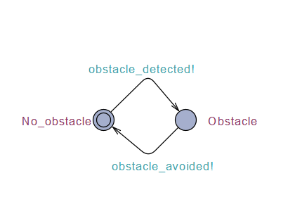
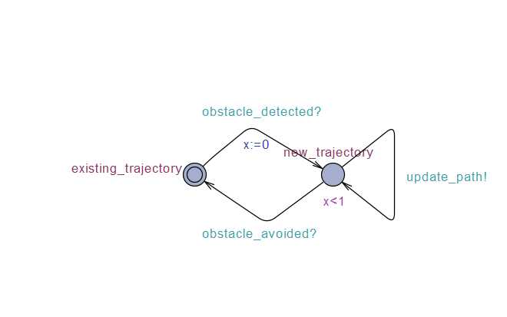
Emulator and Obstacle Avoider

Slide 21
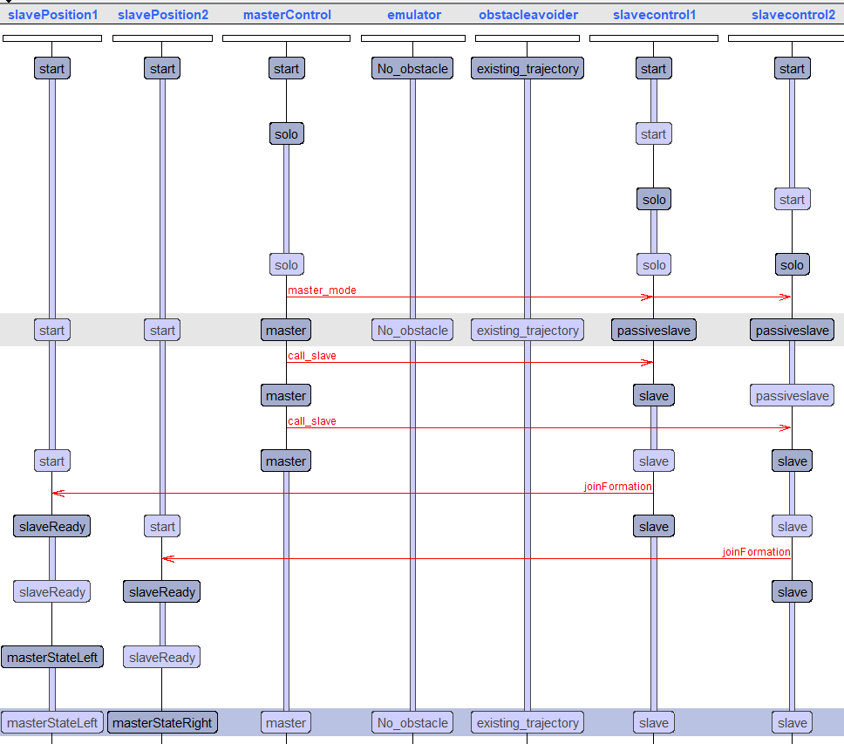
Sequence Diagram

Slide 22
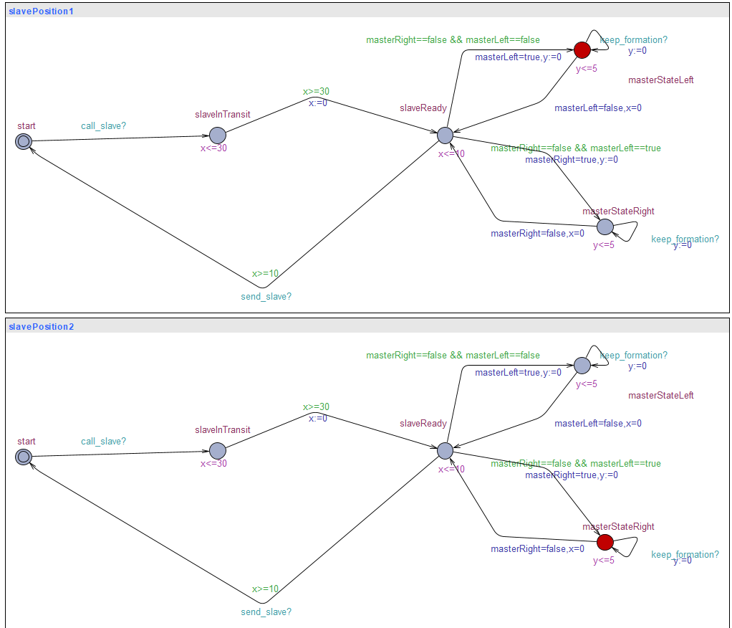
Parked Slaves

Slide 23
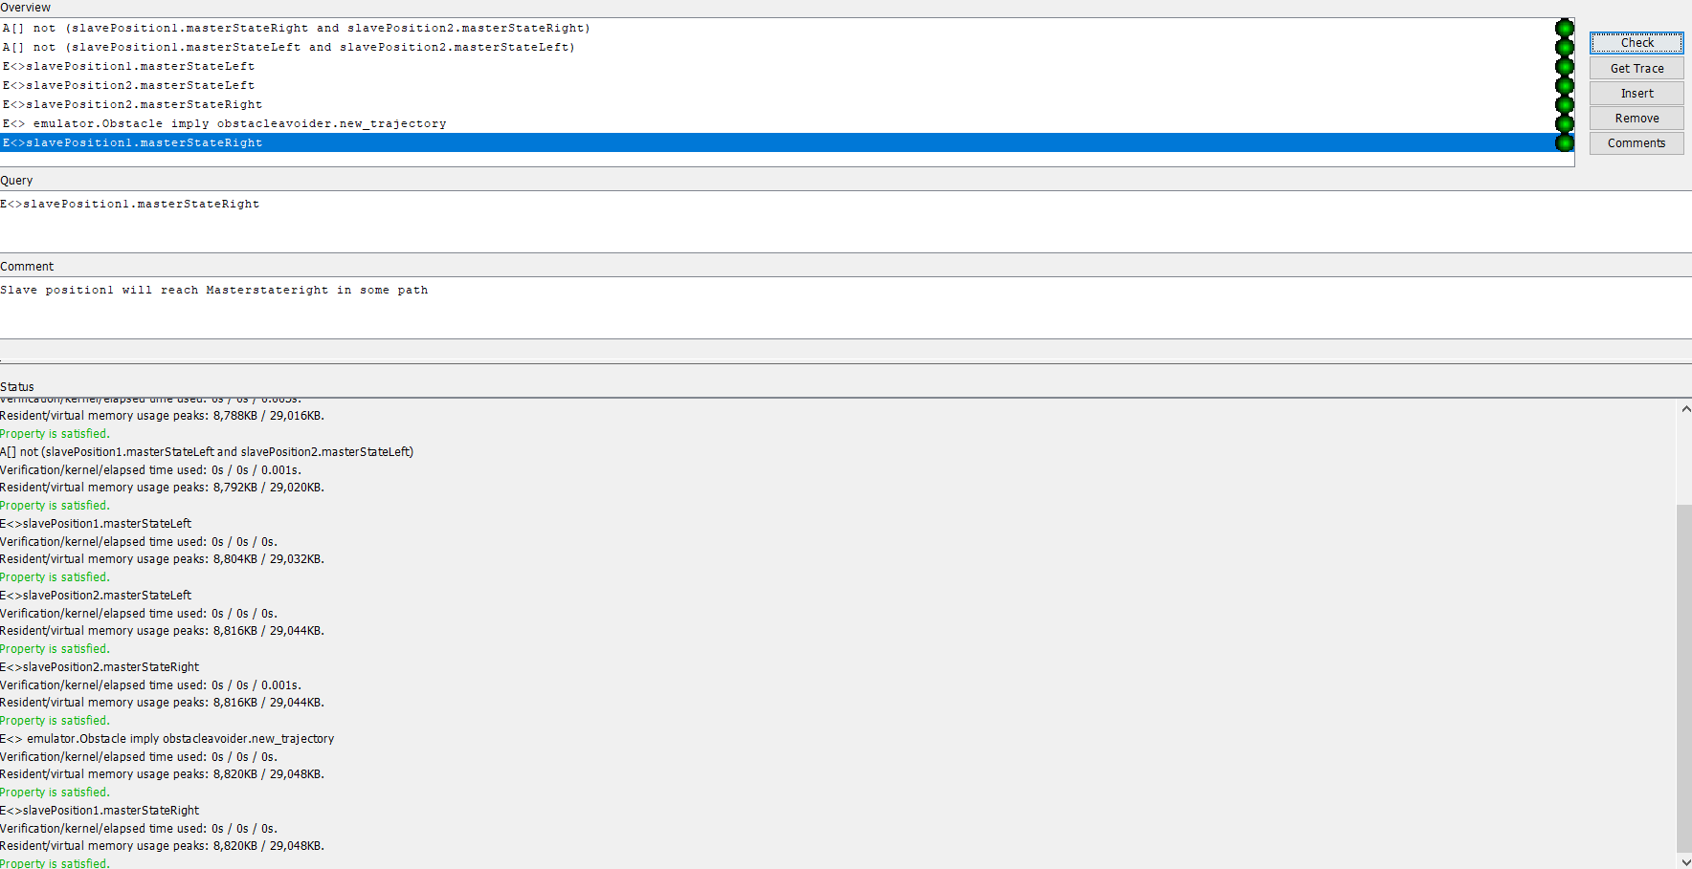
Uppaal Verifier

Slide 24
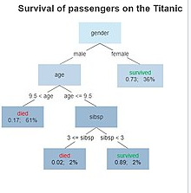
Decision Tree
Decision tree is one of the predictive modelling approaches used in statistics, data mining and machine learning.
Decision trees are constructed via an algorithmic approach that identifies ways to split a data set based on different conditions. It is one of the most widely used and practical methods for supervised learning.
Tree models where the target variable can take a discrete set of values are called classification trees. Decision trees where the target variable can take continuous values (typically real numbers) are called regression.

Slide 25
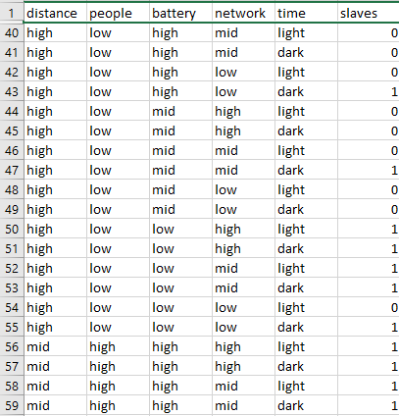
Decision Tree
Decision tree is used in our work for deploying slaves based on some parameters
The parameters considered are
Distance of the bots from wreckage site
How many people are affected in disaster location where slaves need to be deployed
Battery capacity of master bot which becomes master and calls slave
How is the network feasibility between the bots and also remote control where data is continuously transmitted
Time of the day whether it is day or night

Slide 26
References
https://www.google.com/amp/s/www.nbcnews.com/mach/amp/ncna827806
https://www.prnewswire.com/news-releases/gibbs-amphibians-set-to-establish-humdinga-assembly-subsidiary-in-qatar-803433636.html

Slide 27
Git Hub
https://github.com/krupa1106/TheDarkKnights-MechatronicsPeoject

Slide 28
Thank you

